Slide 1
Tutorial on Principal Component Analysis (PCA)
CSE301 Biocomputation, 2016
Bailing Zhang

Slide 2
Dimensionality Reduction
One approach to deal with high dimensional data is by reducing their dimensionality.
Project high dimensional data onto a lower dimensional sub-space using linear or non-linear transformations.
Reduce dimensionality
(K<<N)

Slide 3
Dimensionality Reduction
Linear transformations are simple to compute and tractable.
Classical linear approaches:
Principal Component Analysis (PCA)
Fisher Discriminant Analysis (FDA)
….
k x 1 k x d d x 1 (k<<d)

Slide 4
What is subspace?
Find a basis in a low dimensional sub-space:
Approximate vectors by projecting them in a low dimensional
sub-space:
(1) Original space representation:
(2) Lower-dimensional sub-space representation:
Note: if K=N, then

Slide 5
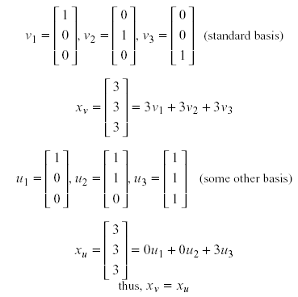
What is subspace?
Example (K=N):

Slide 6
Principal Component Analysis (PCA)
Each dimensionality reduction technique finds an appropriate transformation by satisfying certain criteria (e.g., information loss, data discrimination, etc.)
The goal of PCA is to reduce the dimensionality of the data while retaining as much as possible of the variation present in the dataset.

Slide 7
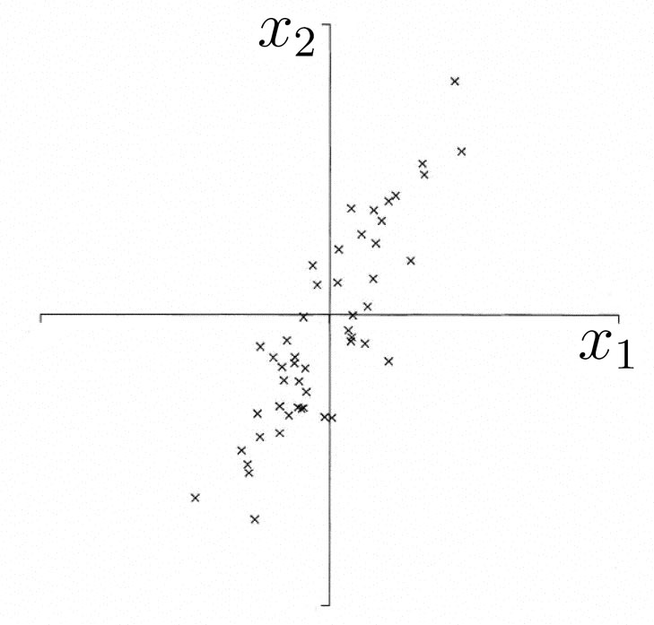
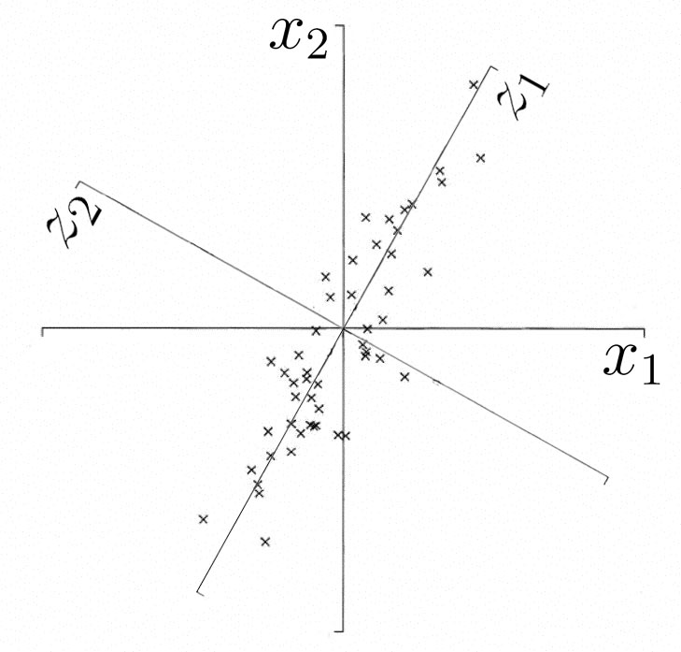
Why Principal Component Analysis?
Motivation
Find bases which has high variance in data
Encode data with small number of bases with low MSE
All principal components start at the origin of the ordinate axes.
First PC is direction of maximum variance from origin
Subsequent PCs are orthogonal to 1st PC and describe maximum residual variance

Slide 8
Derivation of PCs
Assume that
Find q’s maximizing
this!!
From some simple maths, it is maximized when q is the
principal component of R.
Principal component q can be obtained by eigenvector
decomposition such as SVD:
Notes:
all eigenvectors are mutually orthogonal and therefore form a new basis
Eigenvectors for distinct eigenvalues are mutually orthogonal
Eigenvectors corresponding to the same eigenvalue have the property that any linear combination is also an eigenvector with the same eigenvalue; one can then find as many orthogonal eigenvectors as the number of repeats of the eigenvalue.

Slide 9
Review: Eigenvalues and Eigenvectors
If v is a nonzero vector and λ is a number such that
Av = λv, then
v is said to be an eigenvector of A with eigenvalue λ.
Example
λ
(eigenvalues)
A
v
(eigenvectors)

Slide 10

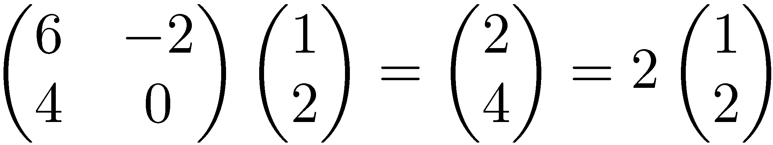
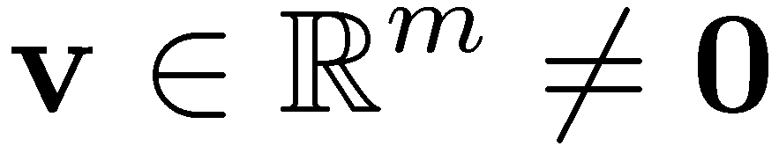

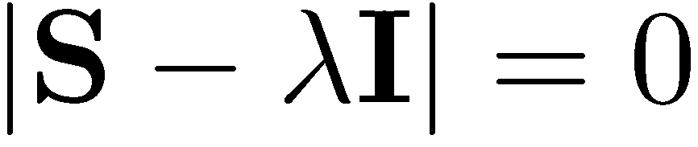
Eigenvalues & Eigenvectors
Eigenvectors (for a square m×m matrix S)
How many eigenvalues are there at most?
Example
(right) eigenvector
eigenvalue
only has a non-zero solution if
this is a m-th order equation in λ which can have at most m distinct solutions (roots of the characteristic polynomial) – can be complex even though S is real.

Slide 11
Eigenvalues & Eigenvectors
For symmetric matrices, eigenvectors for distinct
eigenvalues are orthogonal
All eigenvalues of a real symmetric matrix are real.
All eigenvalues of a positive semidefinite matrix
are non-negative

Slide 12
Example
Let
Then
The eigenvalues are 1 and 3 (nonnegative, real).
The eigenvectors are orthogonal (and real):
Real, symmetric.
Plug in these values and solve for eigenvectors.

Slide 13
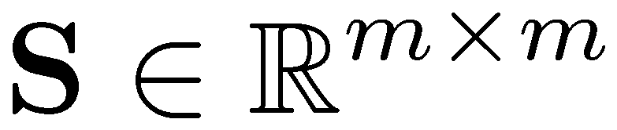
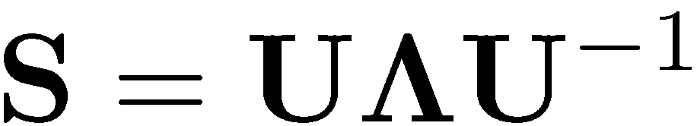


Eigen/diagonal Decomposition
Let be a square matrix with m linearly independent eigenvectors (a “non-defective” matrix)
Theorem: Exists an eigen decomposition
(cf. matrix diagonalization theorem)
Columns of U are eigenvectors of S
Diagonal elements of are eigenvalues of
Unique for distinct eigen-values
diagonal

Slide 14
Diagonal decomposition: why/how
Let U have the eigenvectors as columns:
Then, SU can be written
Thus SU=UΛ, or U^{–1}SU=Λ
And S=UΛU^{–1}.

Slide 15
Diagonal decomposition - example
Recall
The eigenvectors and form
Inverting, we have
Recall
UU^{–1} =1.
Then, S=UΛU^{–1} =

Slide 16
Example continued
Let’s divide U (and multiply U^{–1}) by
Then, S=
Q
Λ
(Q⁻¹= Q^{T} )
Why? Stay tuned …

Slide 17
Symmetric Eigen Decomposition
If is a symmetric matrix:
Theorem: Exists a (unique) eigen decomposition
where Q is orthogonal:
Q⁻¹= Q^{T}
Columns of Q are normalized eigenvectors
Columns are orthogonal.
(everything is real)

Slide 18
Exercise
Examine the symmetric eigen decomposition, if any, for each of the following matrices:

Slide 19
Singular Value Decomposition
For an m× n matrix A of rank r, there exists a factorization
(Singular Value Decomposition = SVD) as follows:
m×m
m×n
V is n×n
The columns of U are orthogonal eigenvectors of AA^{T}.
The columns of V are orthogonal eigenvectors of A^{T}A.
Eigenvalues λ₁ … λ_{r} of AA^{T} are the eigenvalues of A^{T}A.
Singular values.

Slide 20
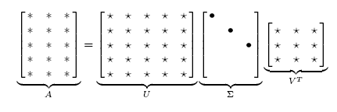
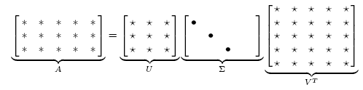
Singular Value Decomposition
Illustration of SVD dimensions and sparseness

Slide 21
SVD example
Let
Thus m=3, n=2. Its SVD is
Typically, the singular values arranged in decreasing order.

Slide 22
Find eigenvalues & eigenvectors by Matlab
Simple commands of matlab
x=[1 3; 2 4];
[v, d]=eig(x)
% Eigenvalues of x in the diagonal of d
% Corresponding eigenvectors in columns of v
Another alternative function (better) is svd

Slide 23
2nd Principal
Component, y₂
1st Principal
Component, y₁

Slide 24
PCA Scores
x_{i2}
y_{i,1}
y_{i,2}
x_{i1}

Slide 25
PCA Eigenvalues
λ₂
λ₁

Slide 26


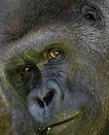


Case study: Eigenface
Face image: high-dimensional vector
NxN image => N² x1 vector
N² -dim space

Slide 27
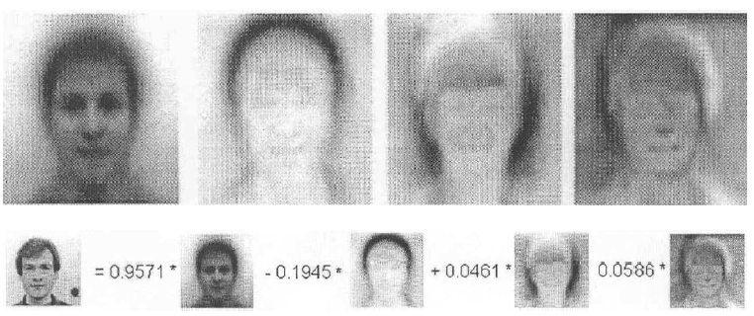
Case study: Eigenface
face image = linear combination of eigenvectors
The eigenvectors of covariance matrix can be viewed as images.
Eigenfaces:
e₁
e₂
e₃
e₄
=0.9571*
+0.1945*
+0.046*
+0.058*
Original
face image

